Slide 1
Shell Scripting for Beginners Jeremy Mills School of Molecular Sciences and The Biodesign Institute

Slide 2
What is a shell script and why do I care?
Why do I care about shell scripts?
If you’re at these workshops, you’re going to be using some sort of *NIX operating system.
Shell scripts can massively simplify a lot of complex actions you’d normally spend time typing and re-typing.
Examples: Parsing large (numbers of) files, moving many files around dynamically, renaming many files, changing a specific thing within many files etc.

Slide 3
What is a shell script and why do I care?
Okay, I’m convinced, so what are these things?
Basically a series of commands you already know or will know soon strung together in a file.
Think of it as printing out your history and committing everything you just did into a file that can be run again and again.
(with some modifications to make those actions more general)

Slide 4
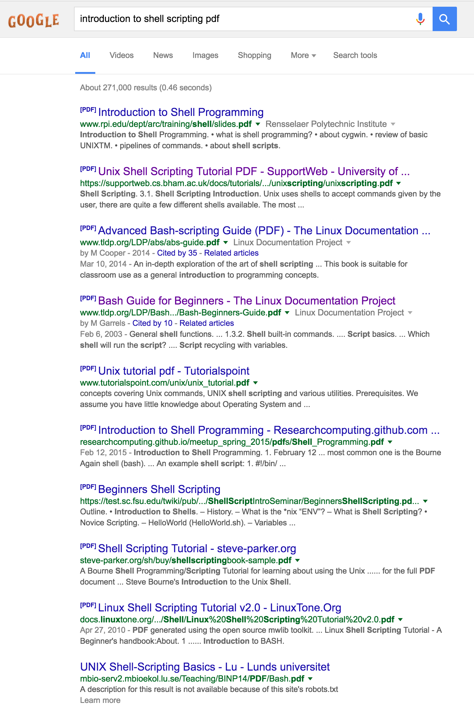
Are there resources I can use?
Certainly…
All of these are pdfs…

Slide 5
Are there resources I can use?
However, there’s no substitute for just trying to use shell scripts all the time when getting started.
When really in trouble, Google is your friend.
Be very specific in your search (difficult at first) and someone will have snarkily answered your question on stackoverflow.com

Slide 6
Useful scripting commands
*I’ll be using the Bourne Again Shell (bash), but the examples will work in others as well (ksh, zsh).
The majority of your scripts will contain relatively few total commands, you’ll just string them together in useful ways.
Please check out Melissa’s terrific Unix notes file for more explanation on these things.

Slide 7
Useful scripting commands
Basic shell commands
pwd
man pwd
echo
cat
rm (-r/-f)
rmdir
cd
ls
cp (-r)
mv
find (-name)
grep
sort
uniq
“print working directory”
“open the manual for this command”
“print a string or a variable to the terminal”
“print the contents of a file”
“remove a file (or, with –r a directory)”
“remove a directory”
“change directory”
“list the contents of the directory”
“copy a file (or with –r a directory)”
“move a file (equivalent to renaming the file)”
*a very useful cmd for finding files
*a very useful cmd for finding things inside files
*“sort the contents of a file”
*“remove duplicates within a file”
* Signifies a command that will generally need options to be useful.

Slide 8
Scripting examples:
Example 1: Writing a first shell script.
As mentioned above, shell scripts are commands that are run from within a file.
To generate these files correctly, one needs to use a text editor, but *NIX systems have many to choose from…
e.g. vim, emacs, pico, nano
And others that aren’t free, but may have better properties for a particular developer.
e.g. sublime, atom

Slide 9
Scripting examples:
Example 1.0: Writing a first shell script.
Before writing our first script, let’s try typing the command:
echo “Hello world!”
Now open your favorite text editor, type:
echo “Hello world! This is a shell script”
Save your new file with the name:
example_1.sh

Slide 10
Scripting examples:
Example 1.1: Running a first shell script.
We now have a file that we can run. There are many ways to do this:
sh example_1.sh
bash example_1.sh
zsh example_1.sh
The above commands all just execute the instructions in the file and differ only with respect to the interpreter used.
Now try the following:
chmod +x example_1.sh
Followed by:
$./example_1.sh

Slide 11
Scripting examples:
Example 2: Using multiple commands
Let’s write a script that prints our username, current directory, and the contents of the directory.
Open a file called example_2.sh.
Type a comment that is ignored by the interpreter:
#Print my username, directory and contents
On a new line, type:
echo “My name is:”
whoami
echo $USER
echo ”The current directory is:”
pwd
echo ”The files in this directory are:”
ls ./
Now save this file.

Slide 12
Scripting examples:
Example 2: Using multiple commands
Let’s run this script:
$sh example_2.sh
Note: your username was printed twice because the commands ”whoami” and ”echo $USER” both do the same thing. Many ways to accomplish things usually exist.
Let’s get rid of one of those commands. How do we do it?
How about adding a comment symbol (#) before one of them?
Let’s save the file and re-run the script.
How did it change?
This shows how simply listing multiple commands in one file can be useful. But not that useful.

Slide 13
Jumping right in… variables and for loops
In order to really take advantage of the power of scripts, we need ways of collecting information on the fly and then doing something with it.
Fortunately, scripts allow us to use variables that are assigned and re-assigned on the fly.
Variable assignment:
string=value
Query a variable’s value:
echo $string
More correctly…
echo ${string}
On the command line, type:
five=5
echo $five
five=4
echo $five
five=seven
echo $five
Notice: The value of the variable “five” changes depending on how you assign it. You can always (and should often) query the value of a variable at a given time with echo.

Slide 14
Jumping right in… variables and for loops
For loops:
Another really important (and very useful) concept is the for loop, which goes through a list of things one by one and does things to them.
Syntax:
for variable in list_of_things
do
[command or series of commands]
done
However…
For loops are most useful when the “list_of_things” is itself generated by a command. Two ways to do this:
for variable in `command` and
for variable in $(command)
This is the backtick. The key with the tilde on it.

Slide 15
Jumping right in… variables and for loops
An example for loop:
for filename in `cat files.txt`
do
echo $filename
done
(this is equivalent to the command cat files.txt)
It should be mentioned that the commands “while” and “until” also exist, but require additional information / commands for correct use.

Slide 16
Scripting examples:
Okay, let’s do something more useful (or at least informative)…
Two new commands:
seq val_1 val_2
touch filename
Print numbers between val_1 and val_2
Create an empty file named filename
Open a file called “example_3.sh” and type:
for num in `seq 1 10`
do
touch file_${num}
done
The output of this script should be that a series of files were created named file_1 through file_10
One doesn’t always need to do things like this in a file. Fortunately, you can write a “one-liner” for this.

Slide 17
Bash one liners
Commands can be strung together on a single line which gives the effect of writing a “script” for single use.
The important thing here is that commands are separated by semicolons.
Rewriting our previous script as a single line:
(first, let’s do this command: rm file_*; ls which should clear our directory of the files we created)
for num in `seq 1 10`; do touch file_${num}; done
The output of the one liner above should be identical to the previous script we ran.

Slide 18
sed: your new best friend.
sed is an incredibly useful program for changing things within files.
To get started, let’s open a file named fox.txt and type the famous pangram “The quick brown fox jumped over the lazy dog” and save it.
Let’s now type the command:
cat fox.txt
This should print the contents of the file to the screen.
Unfortunately, we’re dealing with a slow blue fox instead of a quick brown one. Let’s change that (without opening the file and editing it).

Slide 19
sed: your new best friend.
sed syntax:
sed substitution commands generally take the form:
sed ‘s/word_1/word_2/’ filename
substitute
new word
original word
Execute the following command:
sed ‘s/quick/slow/’ fox.txt
This should print the following to the screen:
The slow brown fox jumped over the lazy dog
However, now run: cat fox.txt
Note: The file has not been changed. To do that takes a bit of extra work. We’ll get to it. But first:

Slide 20
sed: your new best friend.
More on sed syntax:
sed ‘s/word_1/word_2/’ filename
The red slashes are delimiters. The first thing after the s becomes the delimiter and cannot be changed after that. You need three delimiters.
However, these delimiters can basically be any character you like.
sed ‘s$word_1$word_2$’ filename
sed ‘s.word_1.word_2.’ filename
sed ‘s%word_1%word_2%’ filename
sed ‘saword_1aword_2a’ filename
All of the above commands do the same thing as the original command.

Slide 21
sed: your new best friend.
More on sed syntax:
sed ‘s/word_1/word_2/’ filename
Why is the forward slash a common convention?
Quite likely because it’s easy to see. That’s also why you wouldn’t likely use a letter as a delimiter, even though you could.
When should we consider using another delimiter?
Generally important when changing things in full paths which contain many “/” characters.

Slide 22
sed: your new best friend.
Okay, so we know how to use sed. But if it doesn’t actually change the file, how is it useful?
First, that fact is often a feature, not a bug. Use that fact to test your sed commands before actually using them in a script!
Let’s say you do want to change the file. You can always redirect the output to a new file:
sed ‘s/quick/slow/’ fox.txt > fox_2.txt
One can also use the option “-i” to change the original file “in place”. This can be dangerous so vet your script carefully before doing this.
redirects output to fox_2.txt and creates that file if it doesn’t exist.
(and overwrites it if it does! Be careful!)

Slide 23
sed: your new best friend.
Another important thing to know:
The command below will only change the first instance of “quick” in a line to ”slow”
sed ‘s/quick/slow/’ fox.txt > fox_2.txt
Running that command on:
The quick, quick brown fox jumped over the lazy dog
gives:
The slow, quick brown fox jumped over the lazy dog.
To fix this, add “g” at the end of your substitution command:
sed ‘s/quick/slow/g’ fox.txt > fox_2.txt

Slide 24
sed: your new best friend.
Let’s go back to example 3 and use sed to change the names of the files we created:
Recall, our script generates a list of files named “file_1” through ”file_10”. We want to change the names of these files to “data_1” etc. How do we do it?
Well, first, we don’t want to type out the names of the files if we don’t have to. Thankfully, we don’t have to.
Finds all files in the current directory that include “file” in their names.
find . –name “file*”
More importantly, the output of this command can serve as the input for a for loop.
curr. dir
wildcard character
name as opposed to e.g. “type”

Slide 25
sed: your new best friend.
So, let’s change the names of these files:
Open a file named “example_4.sh”
for filename in `find . –name “file*”`
do
echo $filename | sed ‘s/file/data/’
done
What is this?
This is the “pipe” symbol which passes the output of one command to another. It’s super useful for stringing things together.
So this script finds all files with ”file” in their names, ”prints” (echos) them and passes the output of that to the sed command.

Slide 26
sed: your new best friend.
So, let’s change the names of these files:
Open a file named “example_4.sh”
for filename in `find . –name “file*”`
do
echo $filename | sed ‘s/file/data/’
done
We can use the pipe to solve our problem from before:
How do we change “The quick brown fox jumped over the lazy dog” to “The slow blue fox jumped over the lazy dog”?
sed ‘s/quick/slow/’ fox.txt | sed ‘s/brown/blue/’
Note: No need to give it fox.txt as an argument. It gets the input from the original command.

Slide 27
sed: your new best friend.
So, let’s change the names of these files:
Open a file named “example_4.sh”
for filename in `find . –name “file*”`
do
echo $filename | sed ‘s/file/data/’
done
So when we run this, what happens?
The script simply outputs the new names to the terminal.
Now run: ls ./
Note: the file names haven’t been changed.
To change them, we’ll likely use the “mv” command. But how?
We’ll have to store the new name on the fly. We know how to do this, though.

Slide 28
sed: your new best friend.
Let’s change the contents of example_4.sh:
for filename in `find . –name “file*”`
do
newname=`echo $filename | sed ‘s/file/data/’`
mv $filename $newname
done
What have we done here?
We create a new variable, “$newname” that has as its value the output of the sed command.
We can then move the value of the variable $filename to the value of the variable $newname.
Note also the utility of the loop. The value of the $newname variable is maintained only until you iterate again at which time it’s replaced with a new value.

Slide 29
sed: your new best friend.
A big caveat!
for filename in `find . –name “file*”`
do
newname=`echo $filename | sed ‘s/file/data/’`
mv $filename $newname
done
Running this script will change *all* of your filenames. If there’s an error, you can really make life difficult!
It’s therefore good practice to not just execute things like mv commands or sed –i commands without testing first.
Let’s modify the above script to test it first.

Slide 30
sed: your new best friend.
A big caveat!
for filename in `find . –name “file*”`
do
newname=`echo $filename | sed ‘s/file/data/’`
#mv $filename $newname
done
Let’s start by commenting out the mv command.

Slide 31
sed: your new best friend.
A big caveat!
for filename in `find . –name “file*”`
do
newname=`echo $filename | sed ‘s/file/data/’`
echo ”Variable filename is:” $filename
echo “Variable newname is:” $newname
#mv $filename $newname
done
Let’s start by commenting out the mv command.
Next, let’s add some echo commands that will let us know what our script has done.

Slide 32
Another way to parse file names:
A new command:
cut –d_ -f[0-9] string
Cuts a string into pieces
delimiter e.g
/ _ . etc…
The field of interest
We have a bunch of .pdb files in a directory called “data”. Their names are too long for our liking. Can we use the cut command and variables to remove the redundant portion of the file name?
e.g. can we change bpy_8_C3_0010_0001.pdb to bpy_8_0001.pdb for all .pdb files? Yep.

Slide 33
Another way to parse file names:
A file shortening script:
Open a file named shorten.sh
for filename in `find . –name “*.pdb”`
do
first=`echo $filename | cut –d_ -f1-2`
second=`echo $filename | cut –d_ -f5-`
echo $first $second
done
What happens if you don’t have the “echo” before $filename?
Try it if you’d like.

Slide 34
Another way to parse file names:
A file shortening script:
Open a file named shorten.sh
for filename in `find . –name “*.pdb”`
do
first=`echo $filename | cut –d_ -f1-2`
second=`echo $filename | cut –d_ -f5-`
newname=`echo ${first}_${second}`
echo $newname
done
Okay, this looks good. Now let’s string together the first and second parts:
Again, the echo $newname command is meant to ensure everything looks good before moving things. It seems to look good to me!

Slide 35
Another way to parse file names:
A file shortening script:
Open a file named shorten.sh
for filename in `find . –name “*.pdb”`
do
first=`echo $filename | cut –d_ -f1-2`
second=`echo $filename | cut –d_ -f5-`
newname=`echo ${first}_${second}`
mv $filename $newname
done
I have replaced the “echo $newname” command with the mv command from above.
This script will completely replace the filenames in the directory that fit the find criteria, but not change the contents of the files themselves.

Slide 36
Going into files
Often we want to ask questions about what’s in a file (or set of files).
A new command:
grep –o / -v filename
Basically searches within a file for a string
This is an incredibly useful command and can use regular expressions (no time to talk in detail about that, but google some tutorials)
Let’s open one of our .pdb files and see what’s in it.
Okay, so amino acids. Let’s find out how many serines are in this protein.

Slide 37
Going into files
Let’s try to grep for the string “SER” (case sensitive)
grep SER bpy_8_0001.pdb
Okay, it worked, but gave us way more than we wanted.
What you’re grepping for can be put in double quotes to add specificity (i.e. SER with spaces):
grep “ SER “ bpy_8_0001.pdb
We still get too much… Let’s make it more specific:
grep “ SER A “ bpy_8_0001.pdb
Hey, that looks great! Only one chain. But which residues are the serine residues?

Slide 38
Going into files
A new command:
awk [some command]
Great for parsing files
Melissa’s student put together a really awesome tutorial:
https://github.com/mnievesc/Short-Awk-Tutorial
We are going to use awk to parse this file by printing a particular column of interest, but need to start with our grep command first. Why?
awk ‘{print $6}’ bpy_8_0001.pdb
The awk command above would print all values in column 6. However, some of them are empty or contain information we don’t want. Instead, we use grep to first get just what we want:
grep “ SER A “ bpy_8_0001.pdb | awk ‘{print $6}’

Slide 39
Going into files
Okay, so this works, but now we get a whole list of residue numbers.
New commands:
uniq filename
Remove duplicate lines in a file
sort –n –k filename
Sorts a file by user defined parameters
numerical
The “key” of interest

Slide 40
Going into files
Okay, so this works, but now we get a whole list of residue numbers.
New commands:
uniq filename
Remove duplicate lines in a file
sort –n –k filename
Sorts a file by user defined parameters
Prints the first x lines of a file (default 10) to the terminal
head –[0-9] filename
Prints the last x lines of a file (default 10) to the terminal
tail –[0-9] filename
wc filename
Word count a file. Gives a lot of useful information

Slide 41
Going into files
So let’s write a grand finale script putting all of this stuff together:
Our script will:
Find all files of a certain type in a directory
Rename those files
Grep for all serines in one chain
Identify which residues those are in the protein
Identify how many serines there are in the protein
Output this information to a file

Slide 42
A final script
Open a file named finale.sh
for filename in `find . –name “*.pdb”`
do
first=`echo $filename | cut –d_ -f1-2`
second=`echo $filename | cut –d_ -f5-`
newname=`echo ${first}_${second}`
mv $filename $newname
done
for filename in `find . –name “*.pdb”`
do
ser=`grep “ SER A “ $filename | awk ‘{print $6}’ | uniq > temp`
number=`wc temp | awk ‘{print $1}’`
echo “Protein $filename has serines at positions:” >> final_file
cat temp >> final_file
echo -e “For a total of $number serines\n” >> final_file
done
rm temp

